Slide 1
WORLD POPULATION ANALYSIS
Veluru Jogi Reddy
2320938

Slide 2
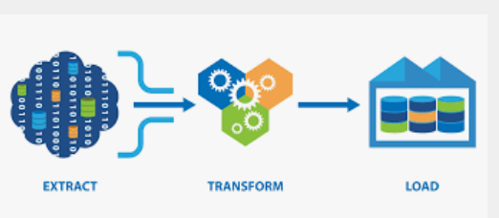
ETL
EXTRACT:Extracting data from source.
TRANSFORM : Cleanse the data to improve data quality and establish consistency
LOAD: Load data into a target database

Slide 3
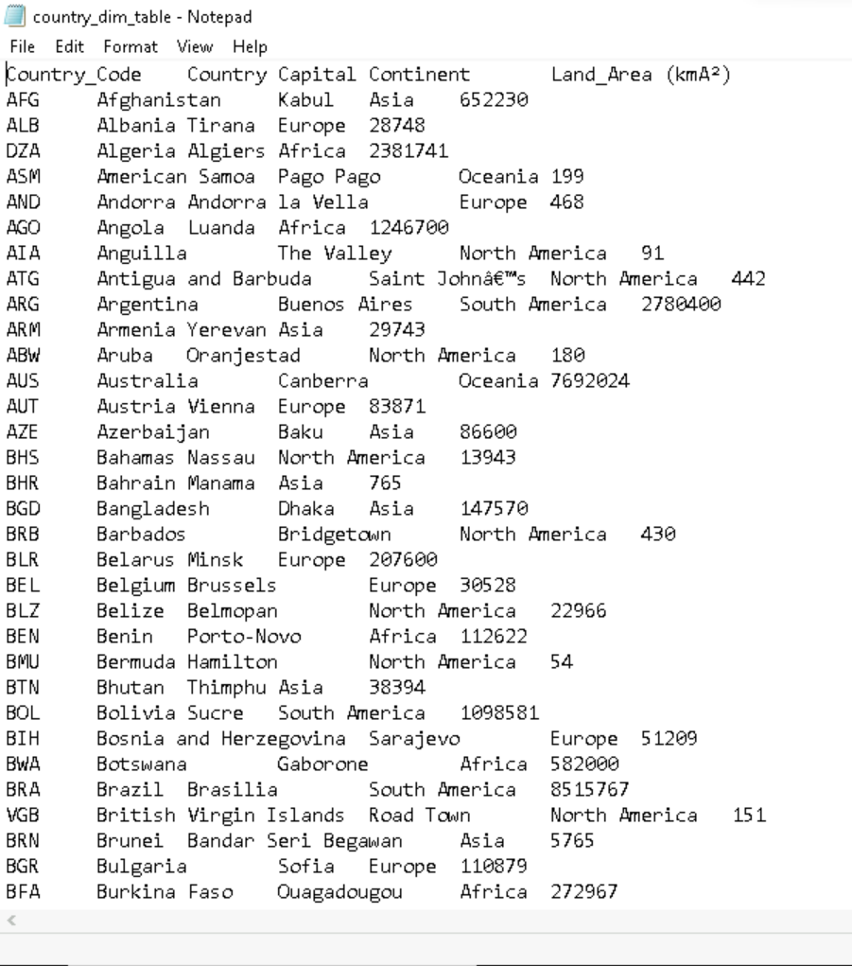
Source
Country Dim
The source is a Flat File.

Slide 4
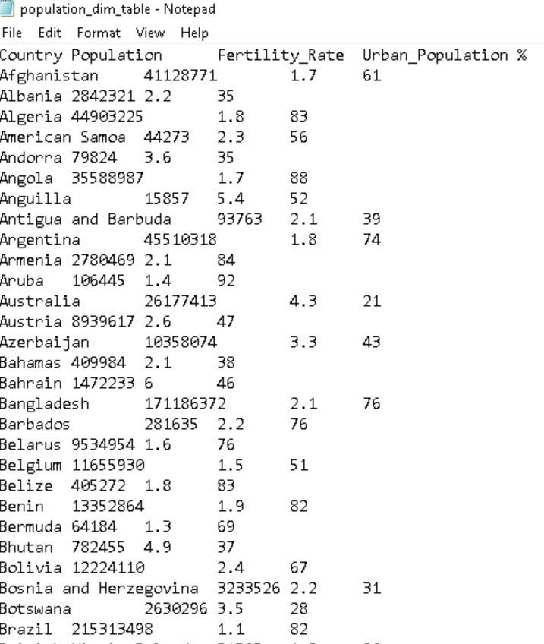
Source
Population Dim

Slide 5
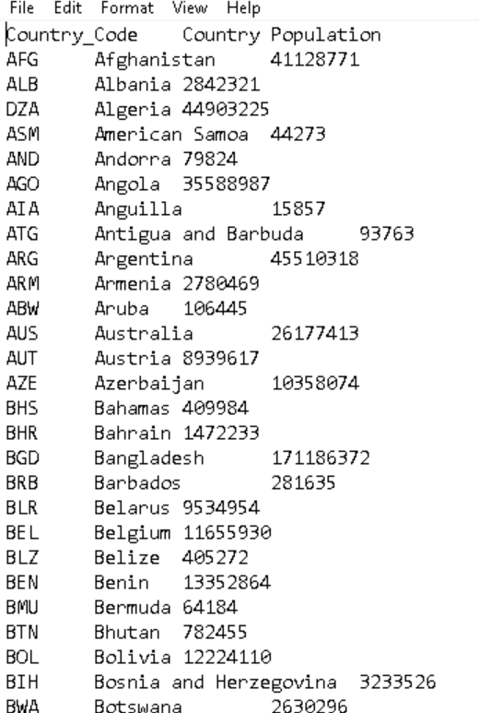
Source
Fact Table

Slide 6
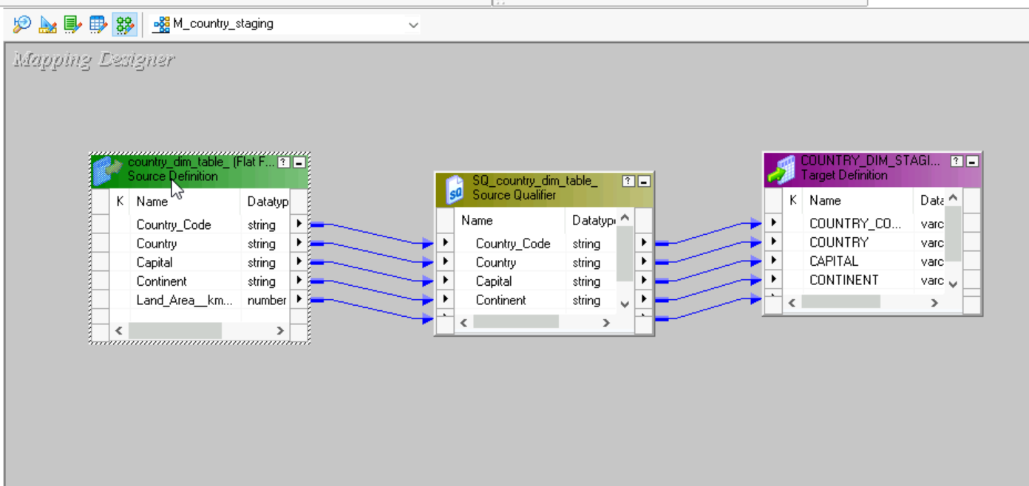
Staging Area
Country Staging
Converting my flat file source into a relational table using the below mapping.

Slide 7
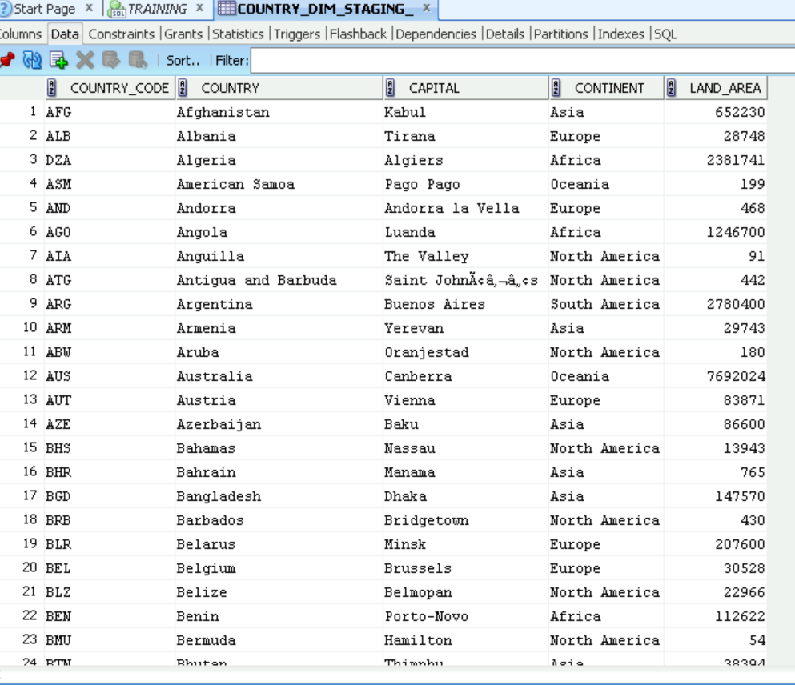
Staging Output (Country Dim)

Slide 8
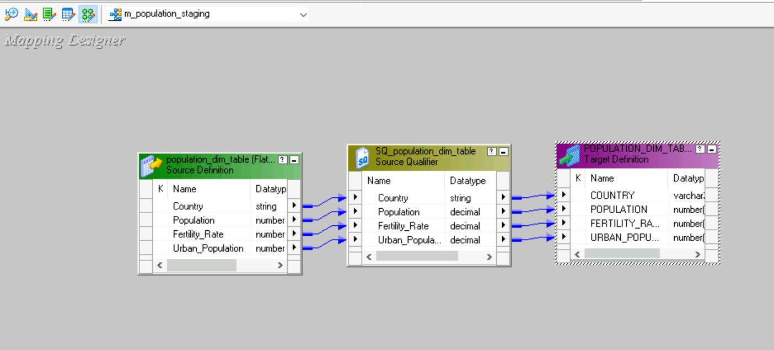
Staging Area
population Staging
Converting my flat file source into a relational table using the below mapping.

Slide 9
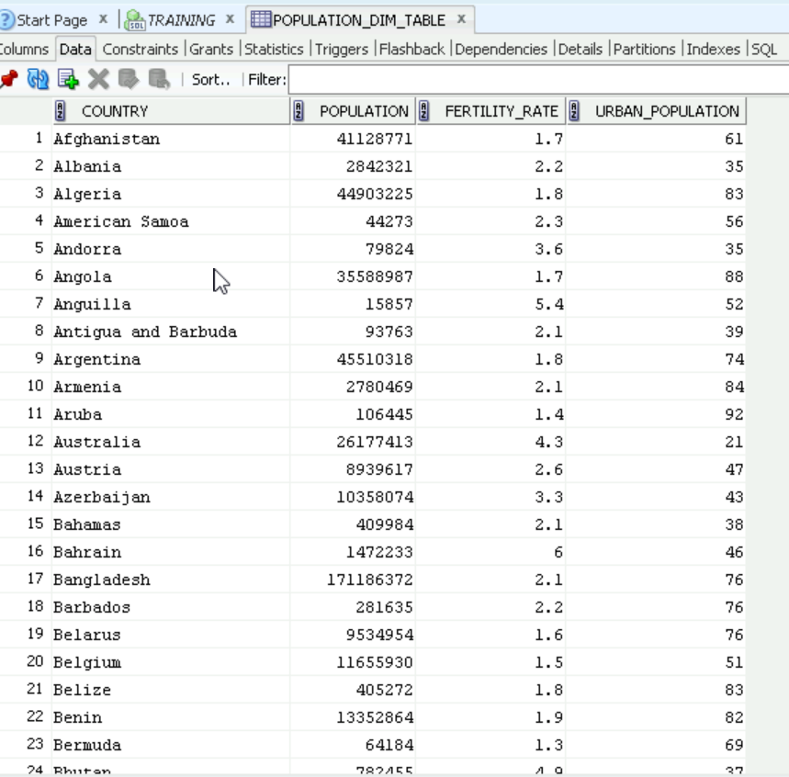
Staging Output (Population Dim)

Slide 10
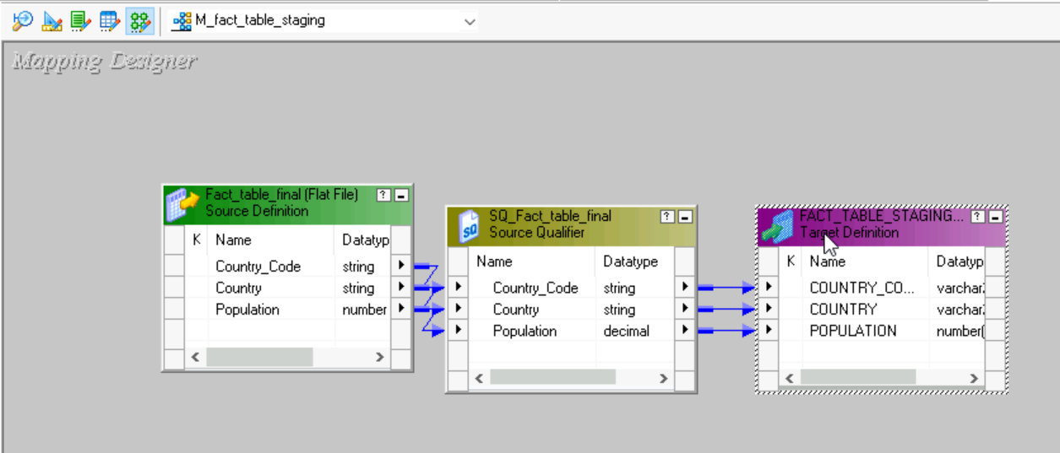
Staging Area
Fact Table Staging
Converting my flat file source into a relational table using the below mapping.

Slide 11
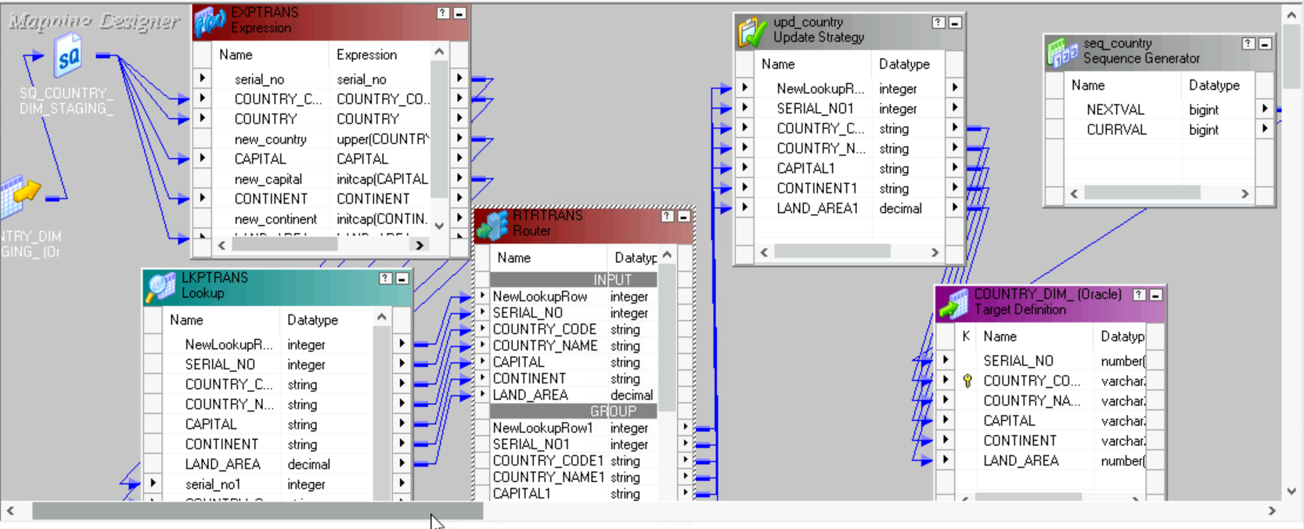
Country Mapping

Slide 12
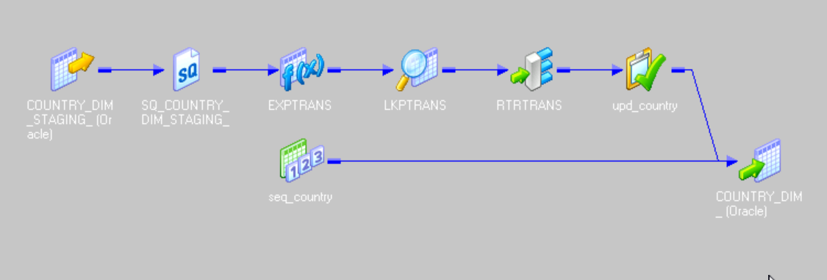
Country Mapping (iconic)

Slide 13
Transformations Used
Expression:
Upper(Country)
Initcap(Capital)
Initcap(Continent)
Router:
NewLookupRow=1 OR NewLookupRow=2
Update Strategy:
iff(NewLookupRow1=1,DD_INSERT,DD_UPDATE)
Expression
Lookup
Router
Update strategy
Sequence Generator

Slide 14
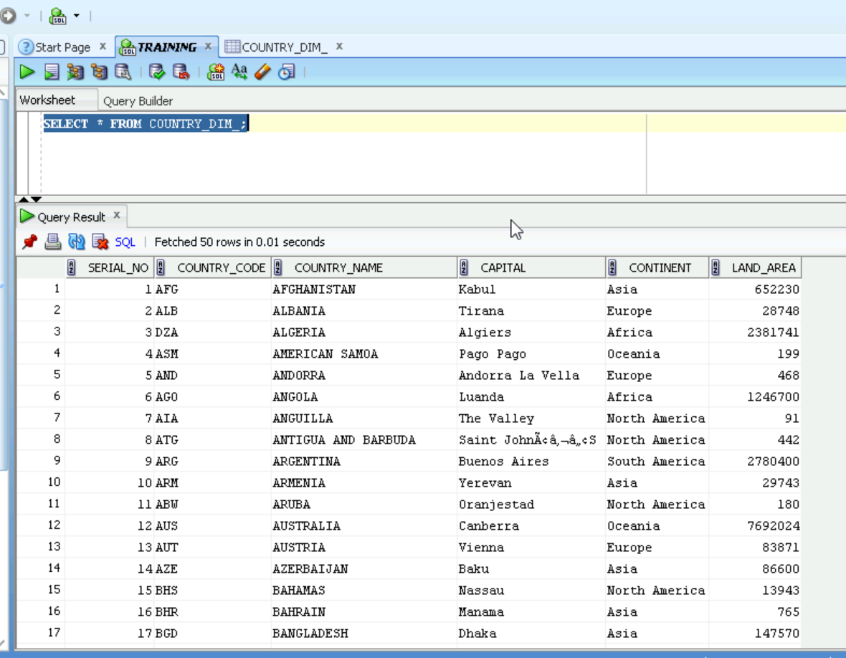
Country Output

Slide 15
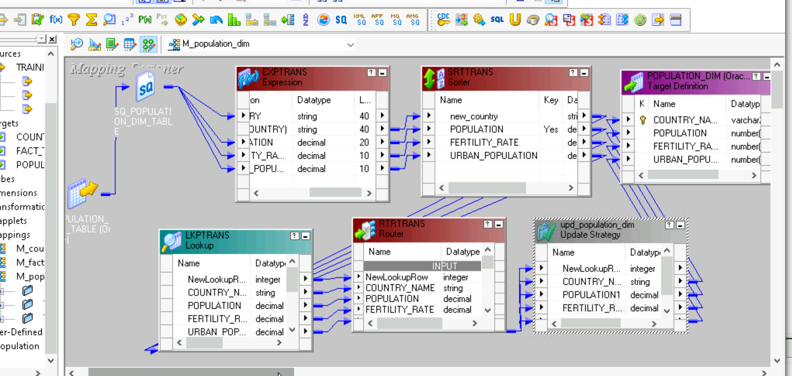
Population Mapping

Slide 16
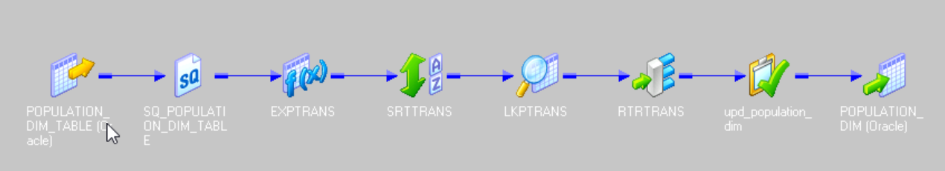
Population Mapping (iconic)

Slide 17
Transformations Used
Expression:
upper(Country)
Router:
NewLookupRow=1 OR NewLookupRow=2
Update Strategy:
iff(NewLookupRow1=1,DD_INSERT,DD_UPDATE)
Expression
Lookup
Router
Update strategy
Sorter

Slide 18
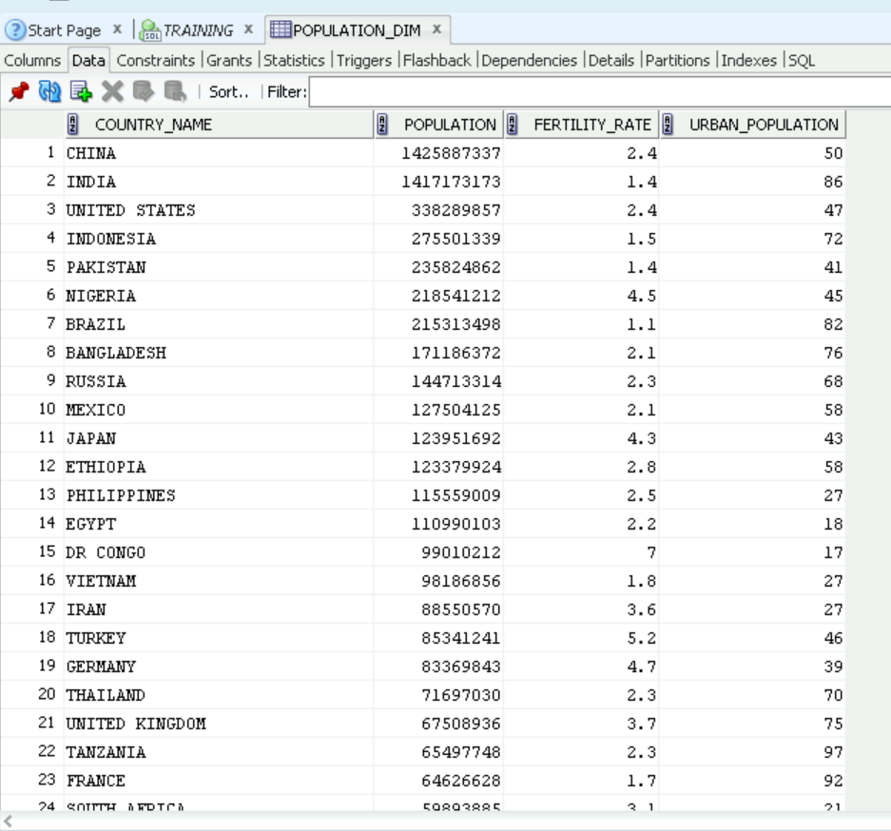
Population Output

Slide 19
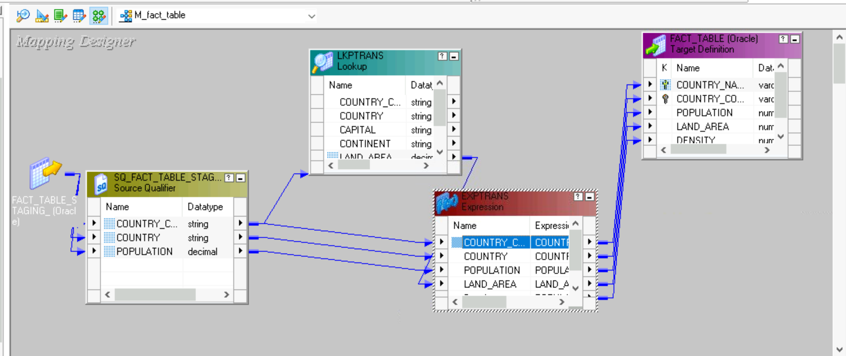
Fact Table Mapping

Slide 20
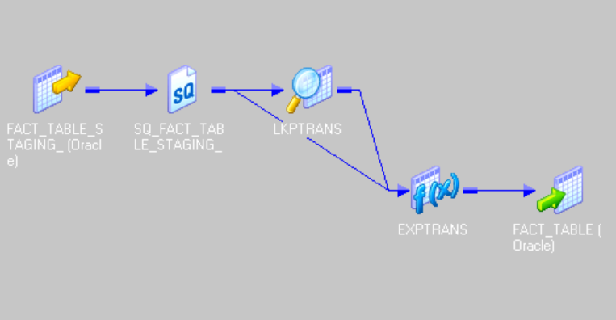
Fact Table Mapping (iconic)

Slide 21
Transformations Used
Expression:
density= Population/land area
LookUp: source base Lookup.
Expression
LookUp

Slide 22
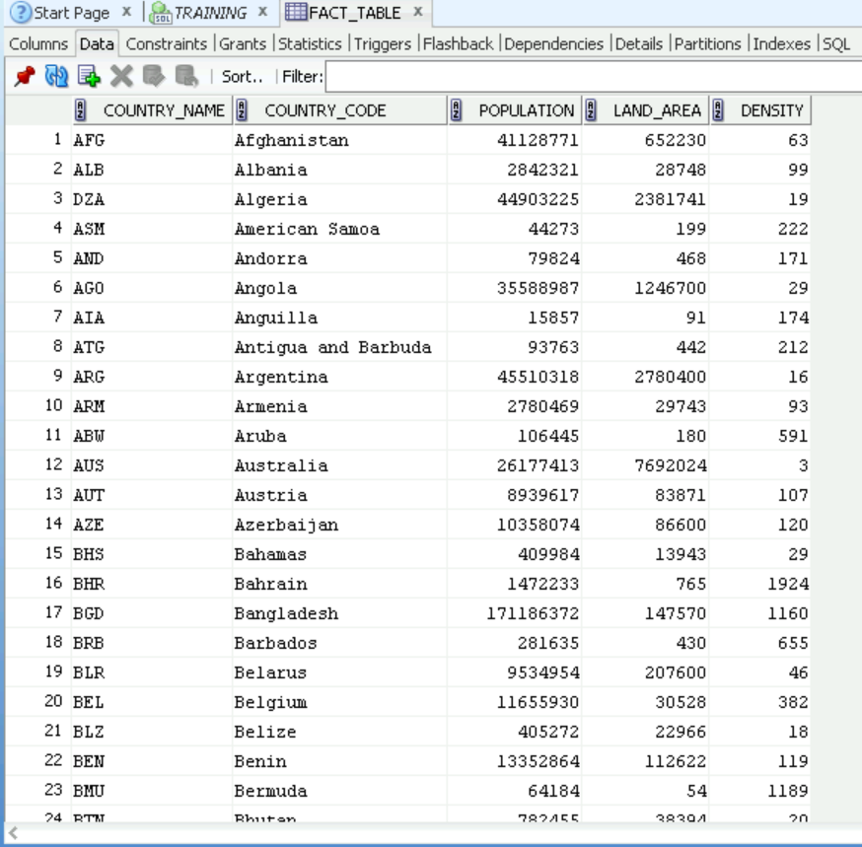
Fact Table Output

Slide 23
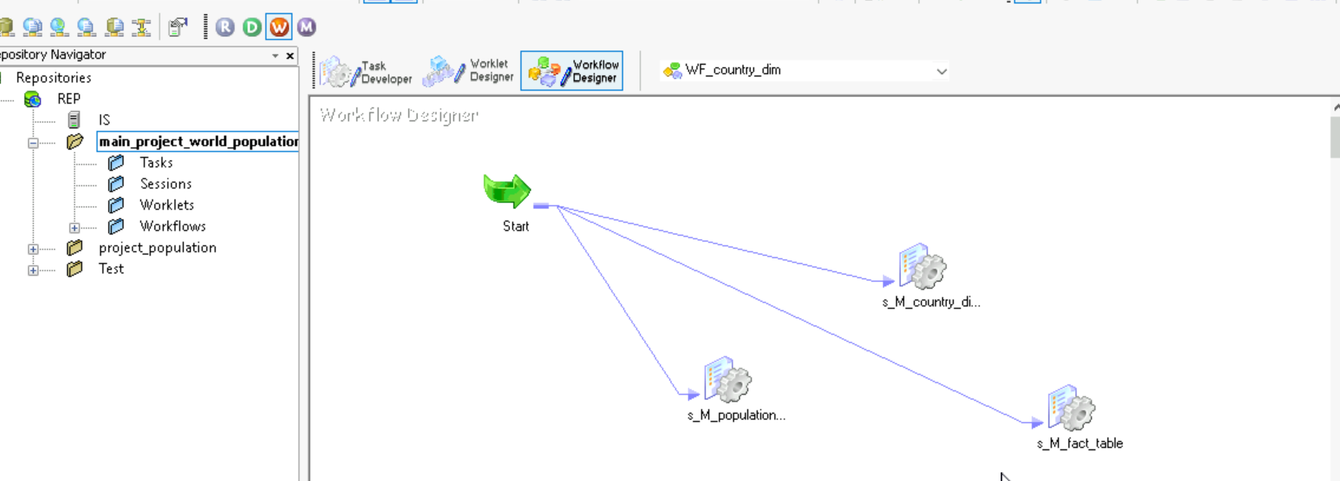
Work Flow

Slide 24
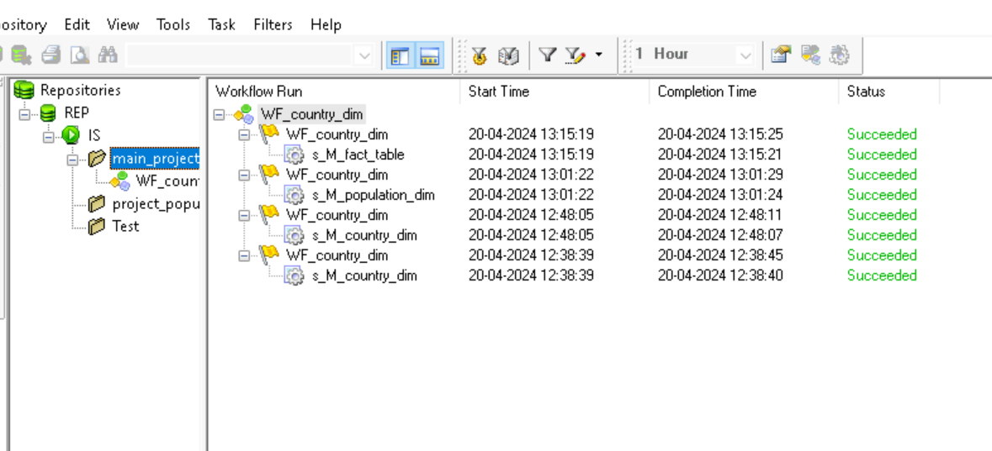
Work Flow Monitor Result:

Slide 25
ETL Validations
Validations:
1)Count Validation
2) Data Validation
3) Null Character Validation
4) Duplicate Validation

Slide 26
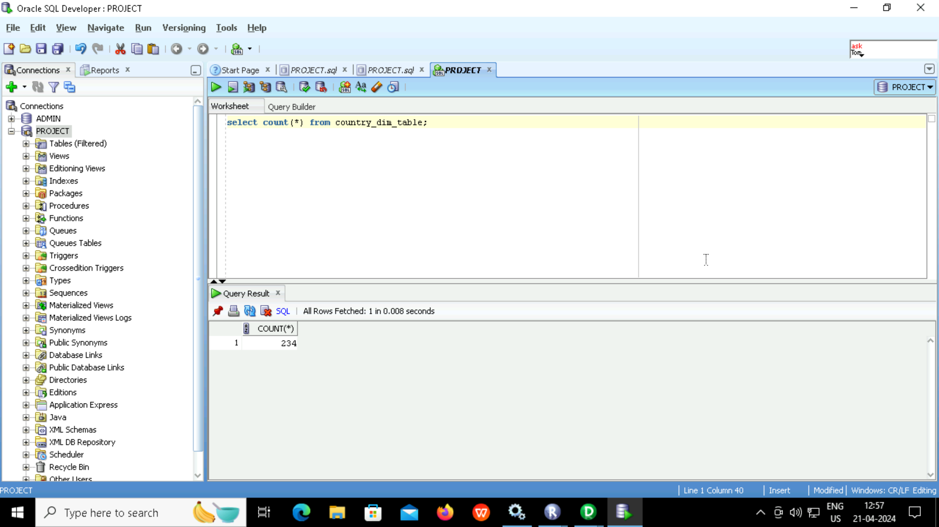

Count validation (Country)
Source
Target

Slide 27


Count validation (Population)
Source
Target

Slide 28
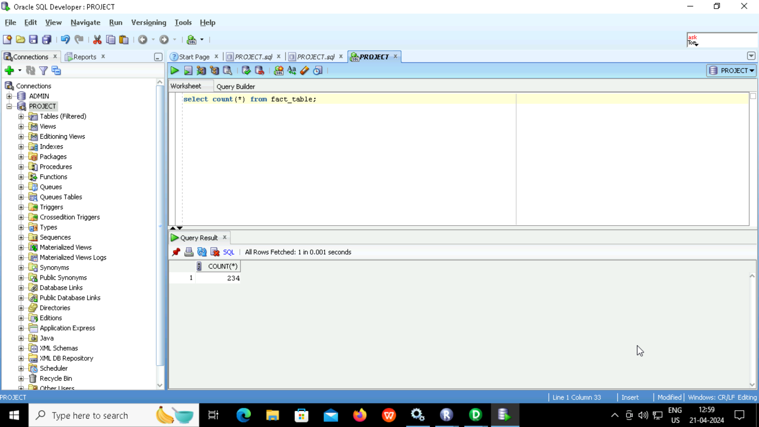

Count validation (Fact Table)
Source
Target

Slide 29
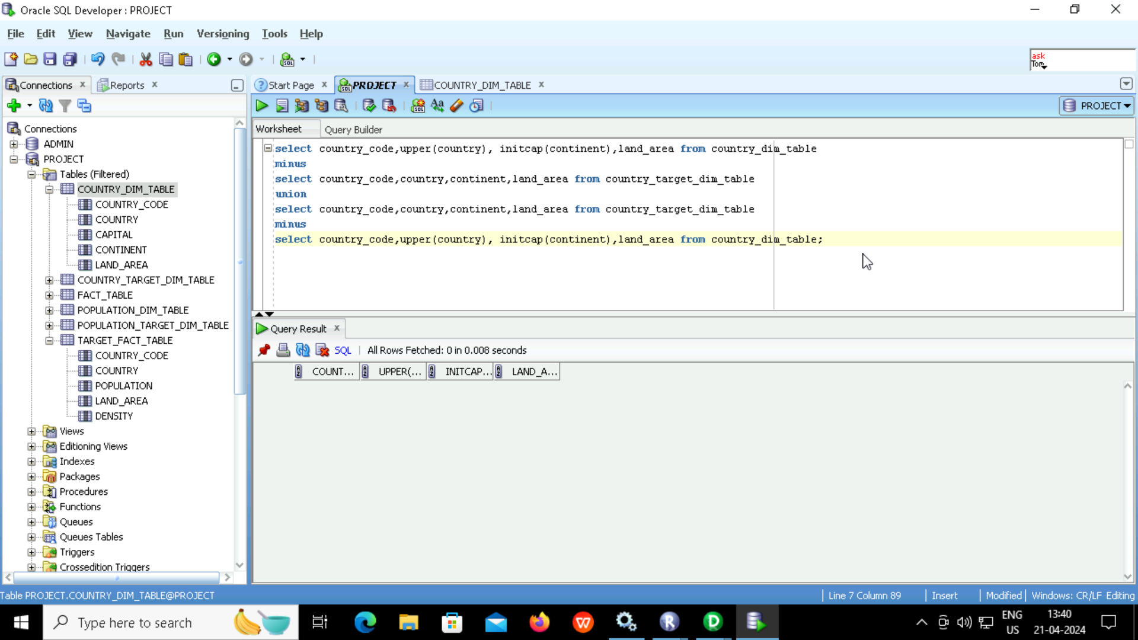
Data validation (Country)

Slide 30
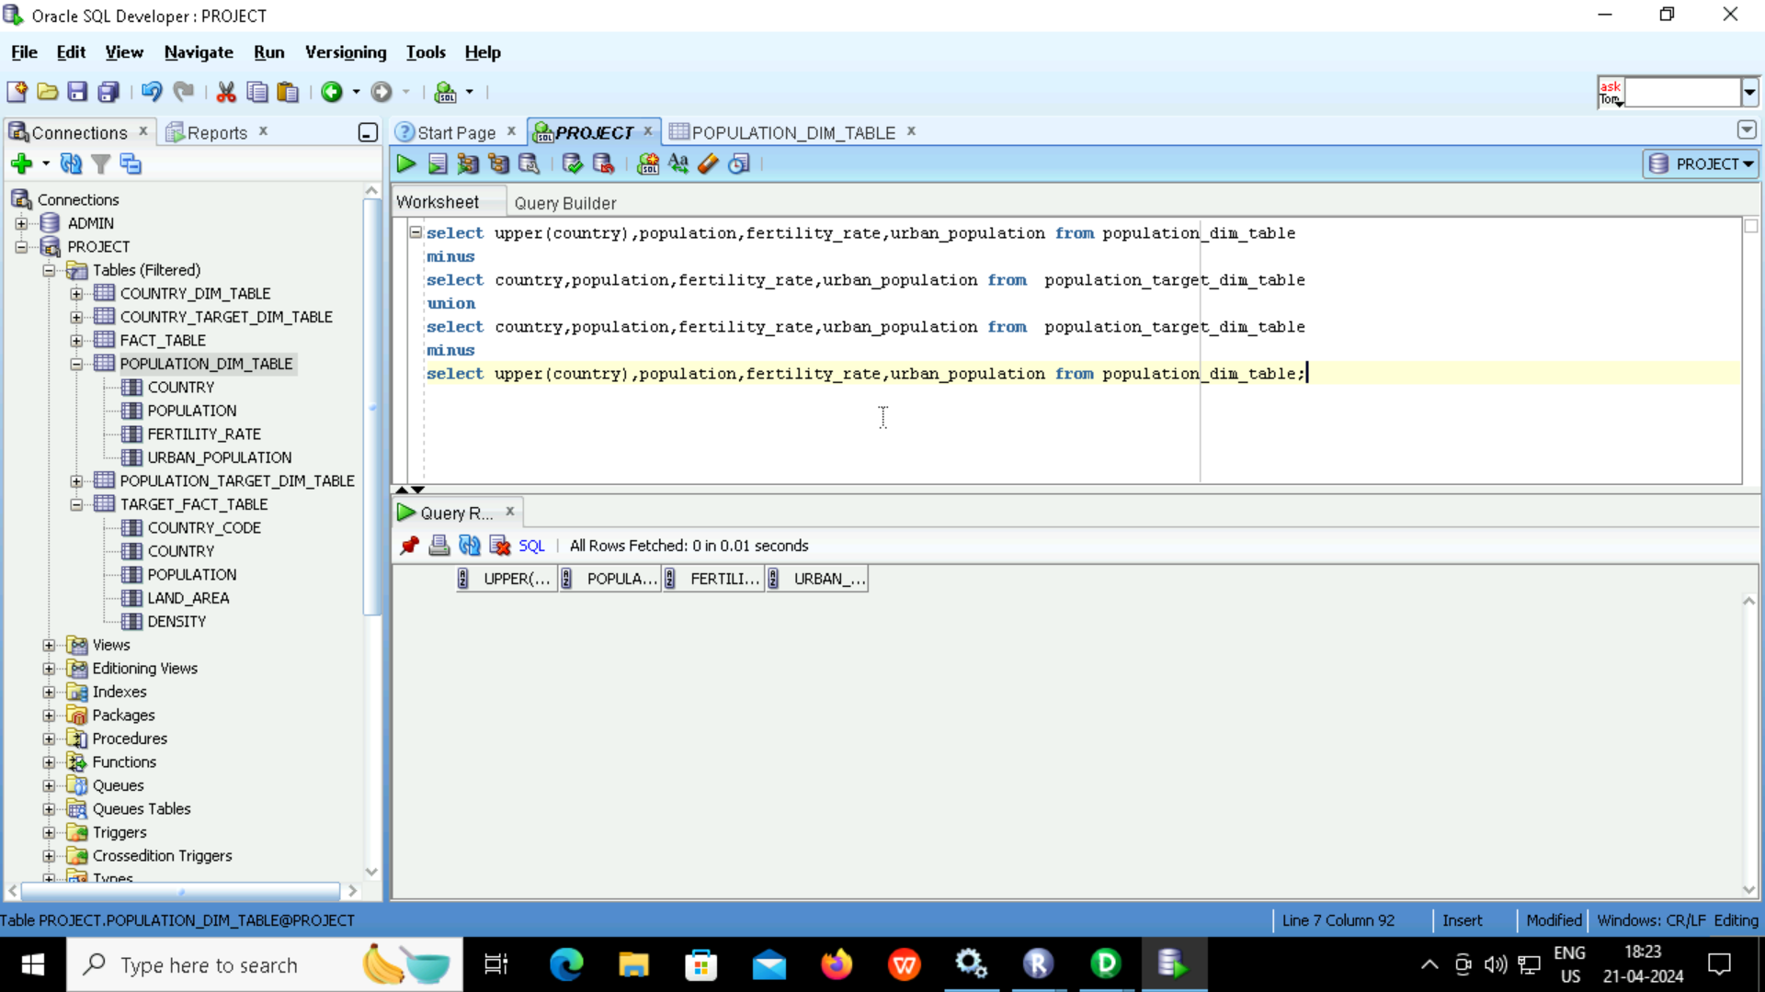
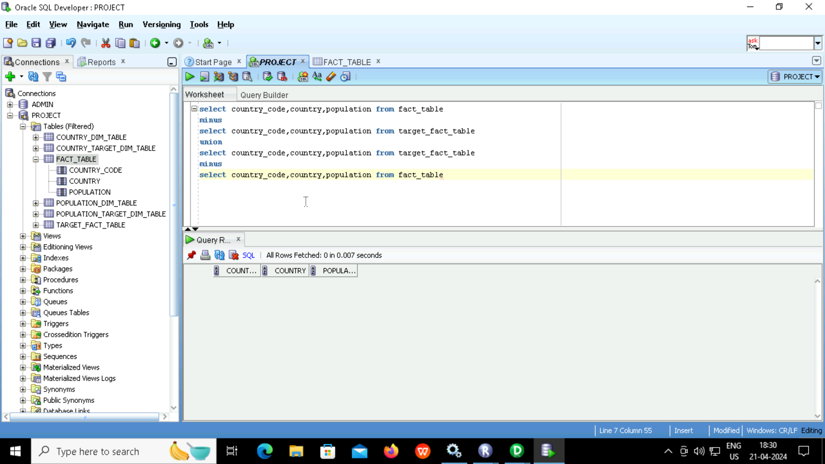
Data validation (Population ,Fact Table)

Slide 31
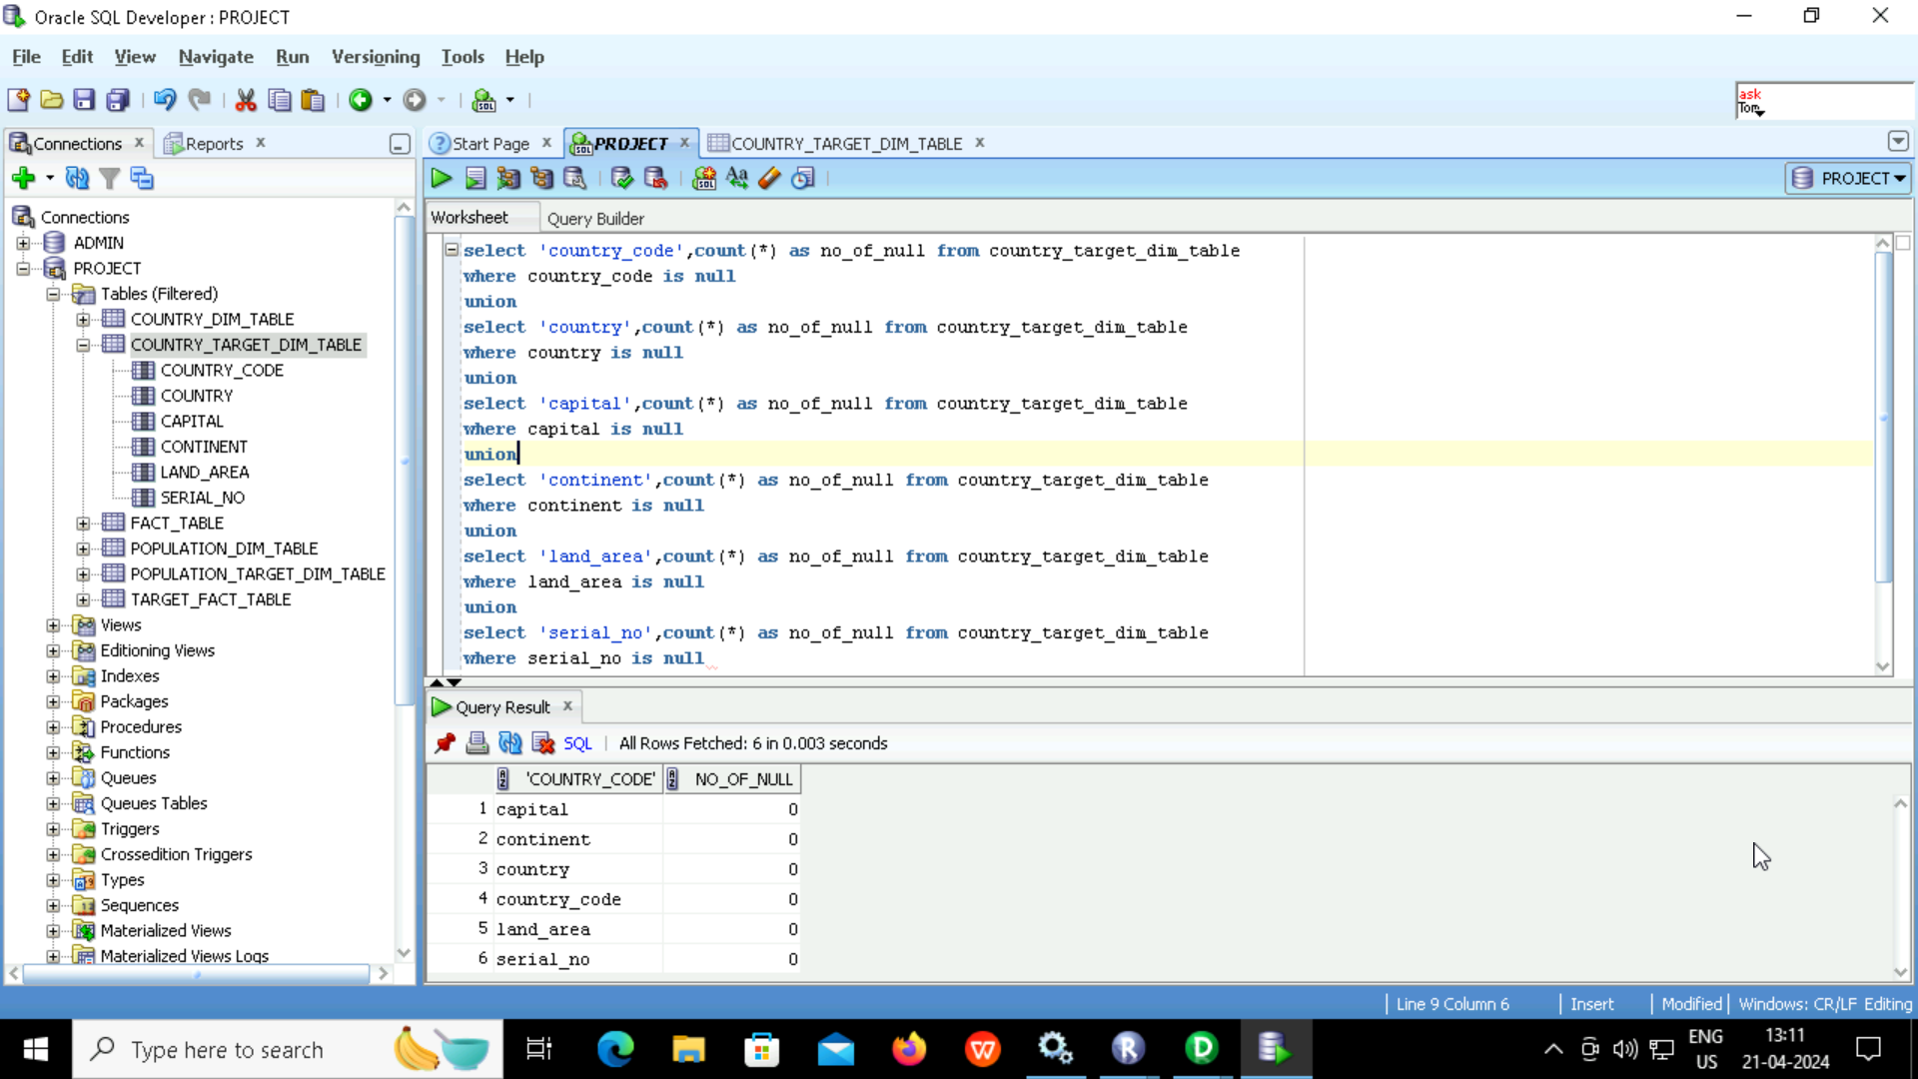
Null Character Validation (Country)

Slide 32
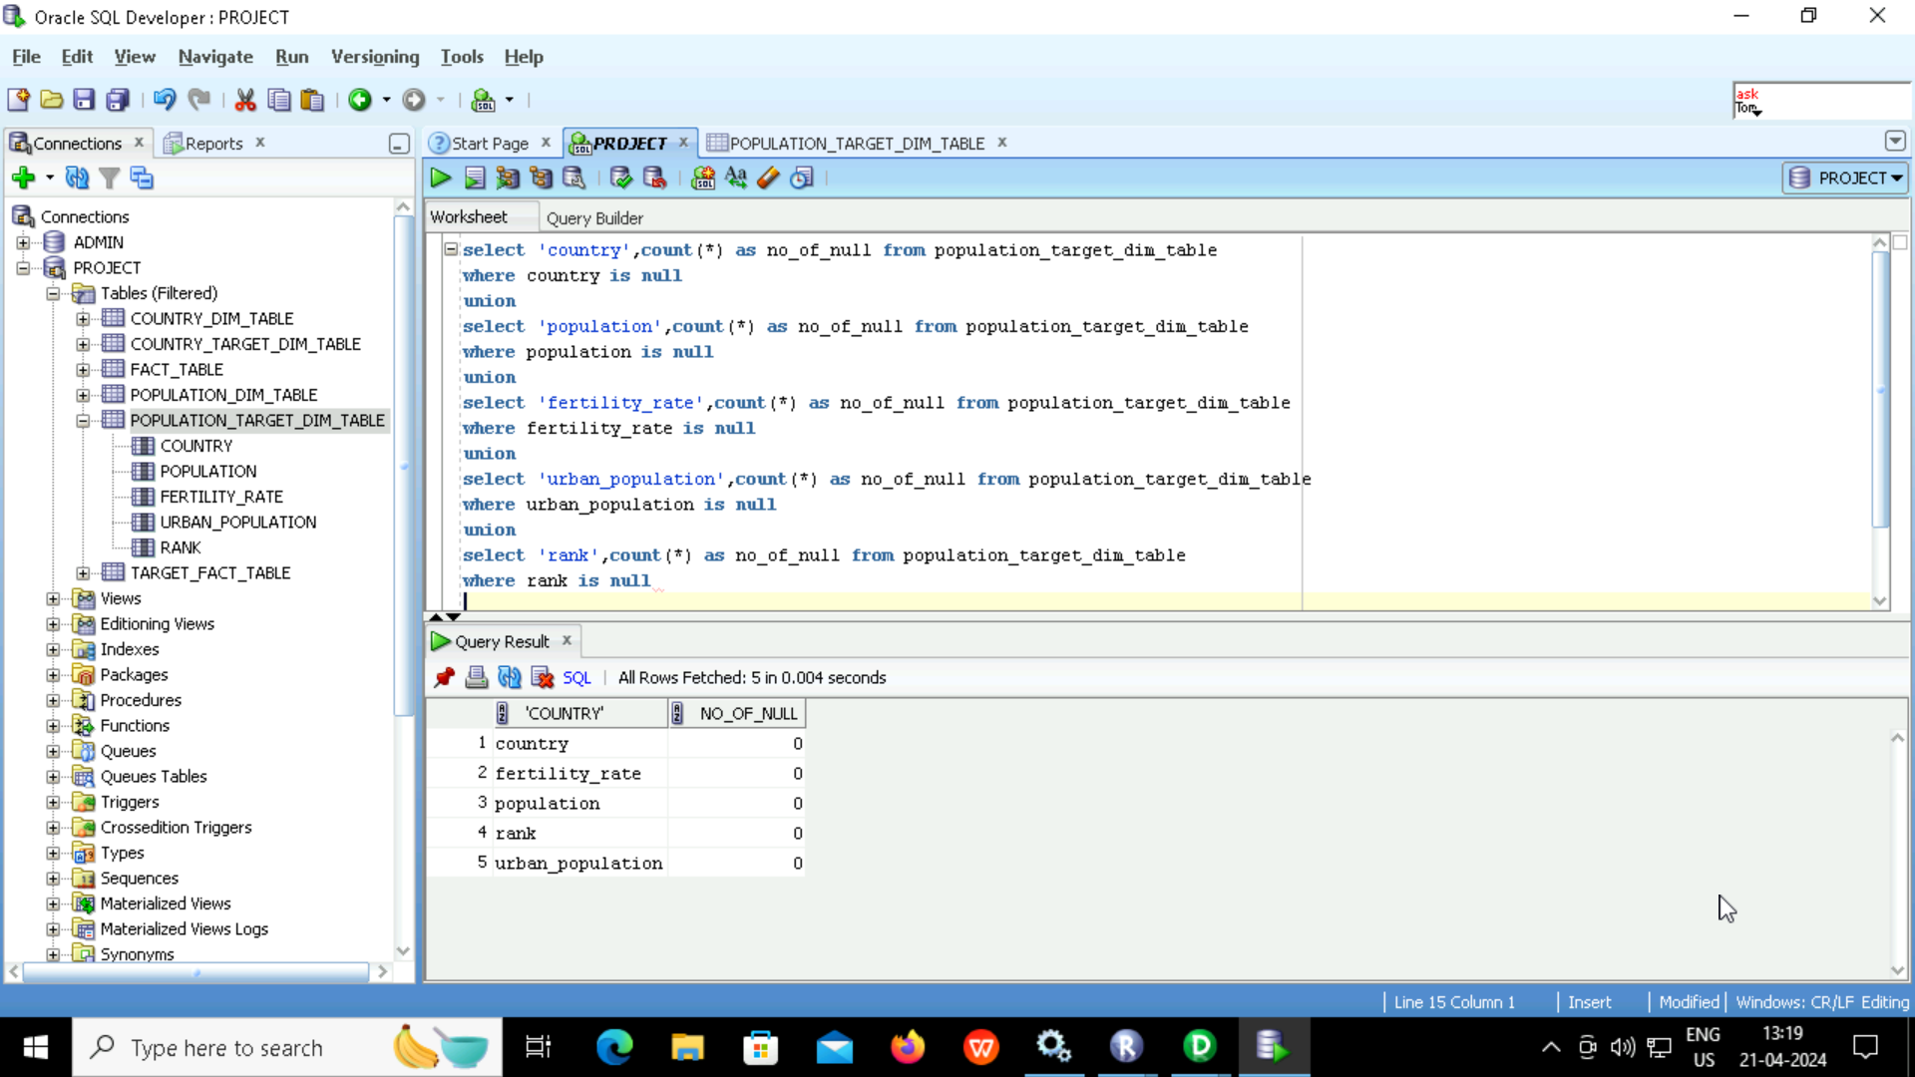
Null Character Validation (Population)

Slide 33
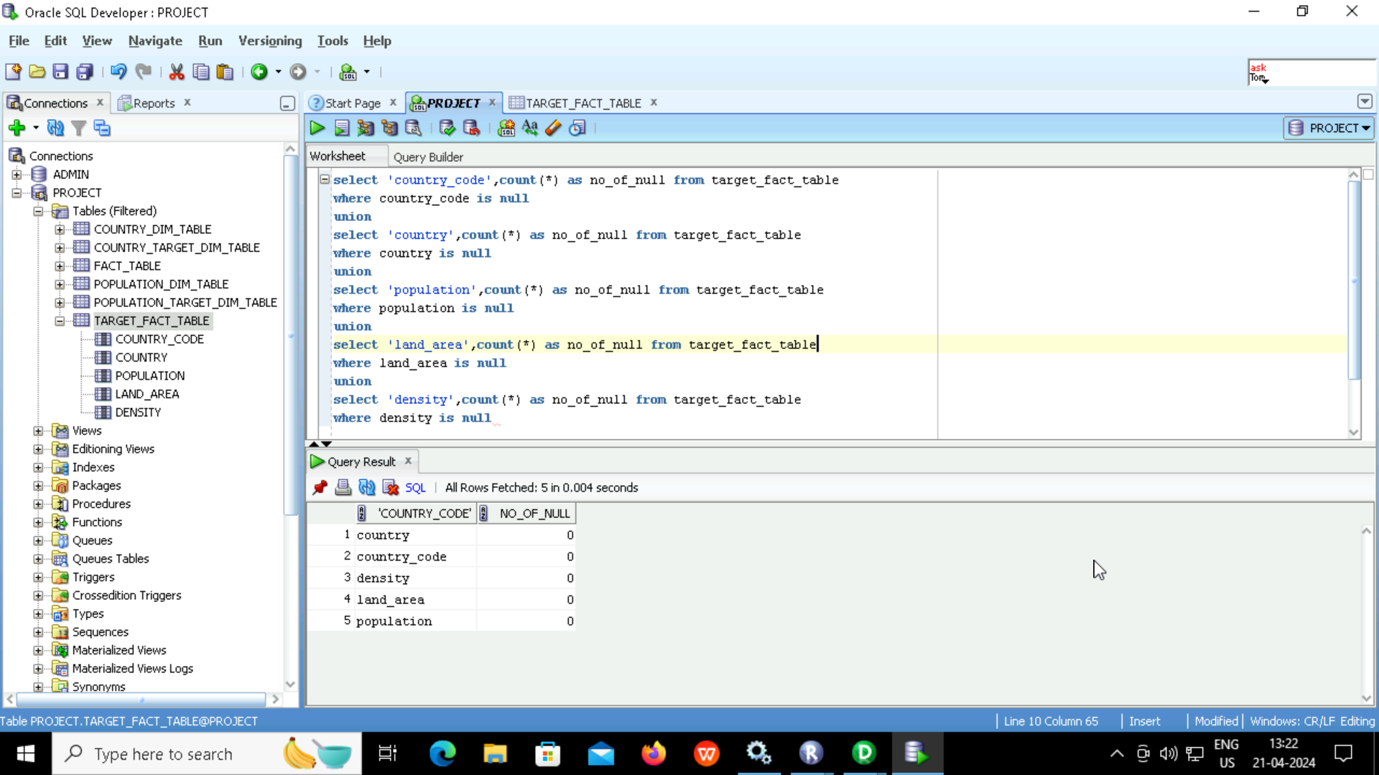
Null Character Validation (Fact Table)

Slide 34
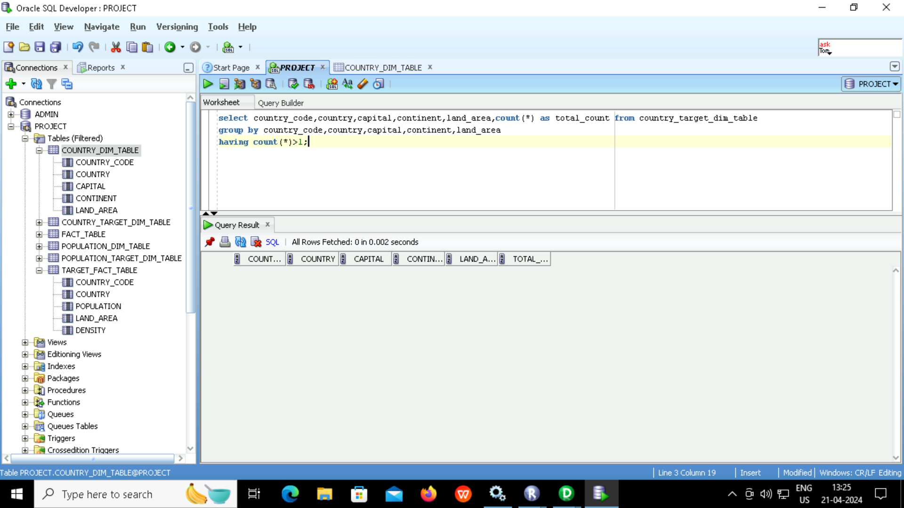
Duplicate Validation (Country)

Slide 35
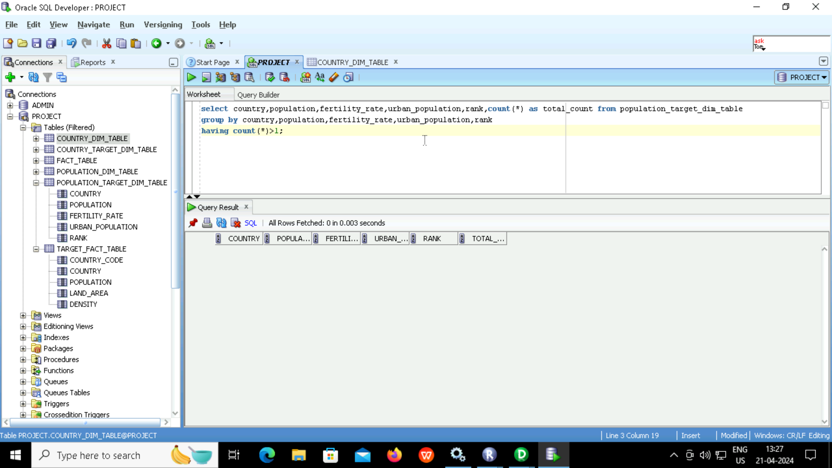
Duplicate Validation (Population)

Slide 36

Duplicate Validation (Fact Table)

Slide 37
Conclusion
There are 2 dimension and one fact table
Country and Population tables are the dimension tables and world population table is the fact table
I have calculated the density of all 234 countries by dividing the population with land area using the required transformations.

Slide 38
Thank You

